Slide 1
TEXTURISING

Slide 2
WHY TEXTURISING
FABRICS MADE FROM TEXTURED YARNS HAVE
SOFTER FEEL
MORE FULLNESS- BULKY
MOISTURE ABSORBTION IMPROVES
THERMAL INSULATION
ELASTICITY

Slide 3
HOW IS IT DONE
INTRODUCE
CRIMPS
COILS
LOOPS

Slide 4
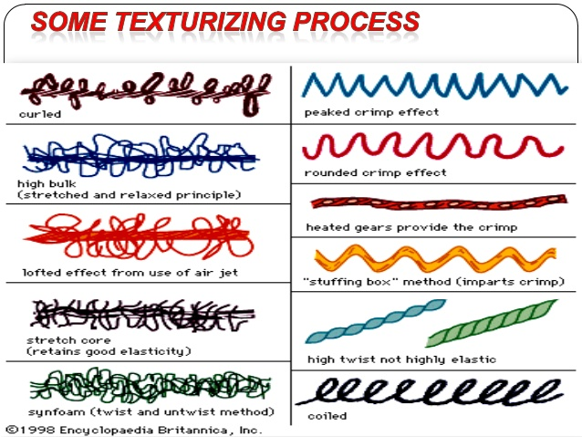

Slide 8
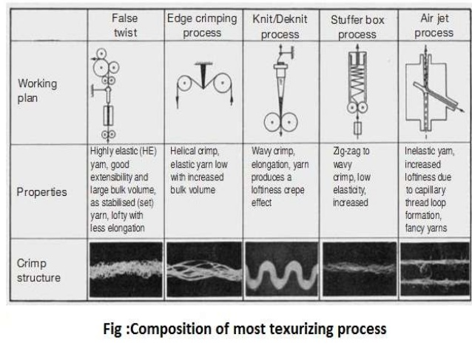

Slide 11
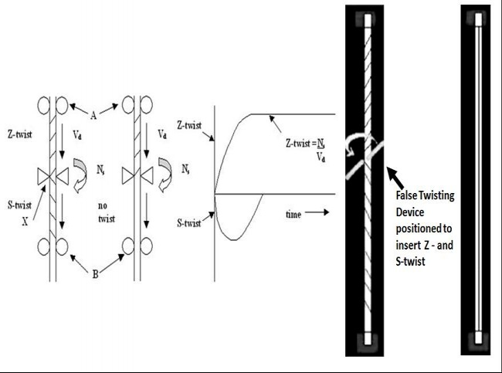
FALSE TWIST TEXTURISING

Slide 12
FALSE TWIST TEXTURISING
When viewed from A, along the length AX, it will appear to be turning clockwise.
Viewed from B, along the length BX, it will appear to turning counter clockwise. In a very short time, the Z-Twist? in the yarn length present in AX will increase to a constant value equal to V_{d} / N_{s} turns per metre.
In zone XB, the S-Twist? present in the yarn length passing through the zone will increase to a maximum value and then decrease to zero. This is because each length of yarn moving from zone AX into zone XB will become untwisted by the counter clockwise torque present in zone XB

Slide 13
FALSE TWIST TEXTURISING
. If the yarn were to be heated above the T_{g} [1] of the polymer while it is being Z-twisted in zone AX, and then cooled before being untwisted in zone XB, the spiral shape of the individual filaments comprising the CF yarn would be retained, but the filaments would become free of the Twist? compaction resulting a false-Twist? textured yarn; bulky with considerable stretch depending on the level of false twisting

Slide 14
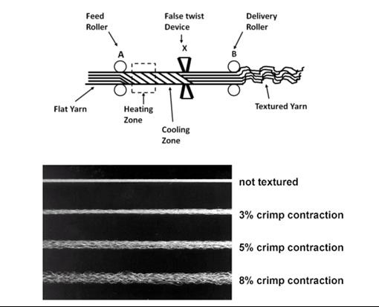
FALSE TWIST TEXTURISING

Slide 15
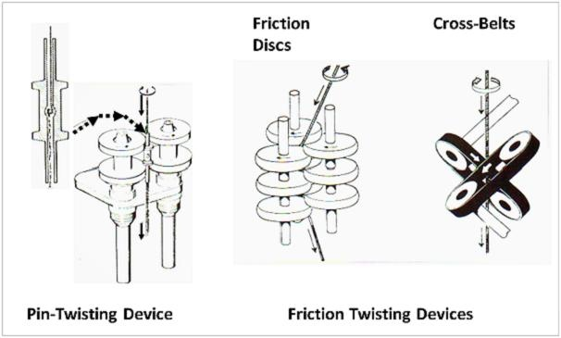
FALSE TWIST TEXTURISING

Slide 16
FALSE TWIST TEXTURISING
The pin twister is a hollow spindle with a central pin positioned across the tubular interior. The flat CF yarn passes down the tube and around the pin.
an assembly of overlapping discs which enables the CF yarn to be directly friction twisted, replacing the need for the hollow spindle

Slide 17
FALSE TWIST TEXTURISING
Another type of friction twisting device used is based on driven cross-belts.
These latter devices enable higher twisting speeds, 20 x10⁶ rpm as opposed to 8 x10⁵ for pin twisting, resulting in production rates of up to 12000m/min, depending on polymer and yarn count

Slide 18
DRAW TEXTURED YARN
By including a mechanical drawing stage(i.e. a hot-draw zone) before the heating/twisting/cooling zone, POY yarns could then be utilised, giving better process economics and product variety in terms of bulk and stretch, depending on the pre-drawing; the yarn being referred to as a draw-textured yarn or DTY

Slide 19
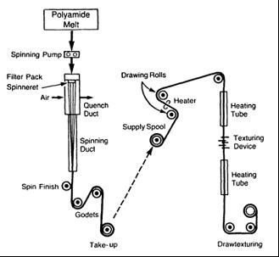
DRAW TEXTURED YARN

Slide 20
DRAW TEXTURED YARN
The melt-spinning of nylon POY. First drawn with a draw ratio of the order of 2.3 to 3.5 at a temperature of at least 50℃ ( Tg = 40ºC), then subjected to simultaneously false twisting (friction disc device) , heating and a further drawing zone with a draw ratio of from 1.1 to 1.5. After the false twisting, the DTY passes through the additional heating zone to become a set-DTY. Count range of from about 10 dtex to about 50 dtex [72]

Slide 21
COUNT RANGE
. Polyester yarns are normally within the count range of 55.6 to 333tex (50 to 300 den), with the emphasis on 83.3 tex to 166.7 tex (75 to 150 den). Nylon yarns are in the range from 16.7 to 122.2 tex (15-110 den); Polypropylene yarns are typically 7.7 to 100tex (70 – 900den)

Slide 22
AIR JET TEXTURISING
AIR-JET TEXTURING has become increasingly important because of it capability to process CF yarns of any polymer type, not just thermoplastics, and also glass filaments.
For example cellulosic rayon which is NOT A THERMOPLASTIC, can be air-jet textured and air-jet textured E-glass is widely used for technical applications.

Slide 23
AIR JET TEXTURISING
AIR-JET TEXTURING CAN BE USED TO PROCESS FDY/FOY (TO GIVE AN AIR- TEXTURED YARN – ATY) OR WITH A PRE-DRAWING STAGE IN AN INTEGRATED DRAW-TEXTURING SYSTEM TO CONVERT POY TO A DRAWN-AIR TEXTURED YARN – DATY)

Slide 24
AIR JET TEXTURISING
Filament? lengths to be textured are fed into the jet much faster than the speed at which they leave the jet, the compressed air entering the jet can then act on the loose Filament? lengths. A ratio > 1, of input to output speed is termed the OVERFEED

Slide 25
AIR JET TEXTURISING
An axial jet, directs the compressed air to the outlet while dragging the filaments along.
A spherical barrier is positioned close to the outlet orifice, so that as the compressed air exits it becomes a turbulent air flow.
The Filament? lengths in the turbulent flow initially become separated, forming a profusion of loops of various sizes. These entangle as the filaments get pulled together by removal rollers, to deliver an air- textured CF yarn.

Slide 26
AIR JET TEXTURISING
A vortex –jet design is better because the compressed air has a spiralling turbulent flow at the outlet.
The loose filament lengths form a profusion of different sizes of entangled loops as they exit the jet

Slide 27
AIR JET TEXTURISING
Usually jets operate at pressures of about 10 bar (140 psi).
The actual texturing occurs directly at the exit of the jet in a turbulent supersonic air stream.
To assist the loop formation, the filaments are wetted prior to entering the jet, by either Spraying? or dipping the yarn into a water bath; the water aids separation of the filaments and acts as a Lubricant?

Slide 28
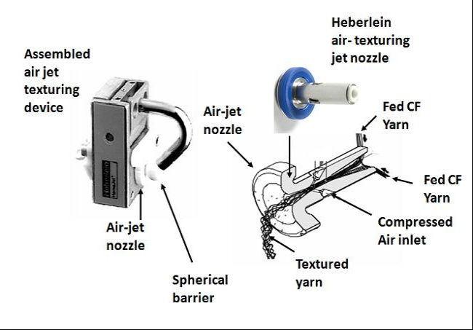

Slide 29
AIR JET TEXTURISING
There are basically 2 types of yarns produced by air jet texturing.
(a) Parallel yarns
(b) Core effect yarns

Slide 30
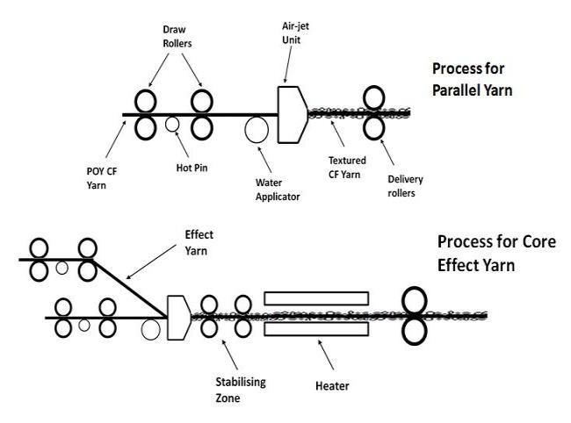

Slide 31
AIR JET TEXTURISING
For parallel yarns one or more POY is fed into the air jet device with same overfeed.
18% to 30% overfeed depending on end-use requirements
Parallel yarns are commonly used in cut pile plush fabrics.

Slide 32
AIR JET TEXTURISING
Core effect yarns require two yarns core and the effect yarns.
The overfeed used for the core yarn(s) is always lower than that for the effect yarn(s); the former, normally between 5 - 15% whereas the latter can be up to 400%.
8% core and 40% effect used for an apparel end-use such as nylon sportswear;
120% effect yarn overfeed for upholstery fabrics, both domestic and car seat upholstery.

