Slide 1
APPLIED MECHANICS
CHAPTER TOPIC
1 INTRODUCTION AND REVIEW OF MATHEMATICS
2 FORCES AND RESULTANTS
3 MOMENTS AND COUPLES
4 EQUILIBRIUM
5 FRICTION
6 KINEMATICS OF LINEAR & ROTATIONAL MOTION
7 KINETICS OF LINEAR MOTION
8 KINETICS OF ROTATIONAL MOTION
Engineering Mechanics – Chapter 1: Introduction & Review of Mathematics
Slide 1 of 19
EE31102005

Slide 2
FORCES AND RESULTANTS
Actions and Effects Of Forces
Force Distributions
Force As A Vector Quantity
Addition Of Forces
Resolution Of Forces
Numerical problems

Slide 3
MOMENTS AND COUPLES
Defination
Units
Mathematical Interpretations
Laws of moments
Application
Varignon’s Theorem of moment
Numericals

Slide 4
FRICTION
Defination
Effects (usefull/Harmfull)
Some important terms related to friction
Laws of Frictions
In Equilibrium Condition
Different cases of frictional effects in sliding friction
Interpretation
Numericals

Slide 5
Simple lifting Machine
Energy:
Ability to do work
Work=
Force x Distance
Force:
A Push or a Pull

Slide 6
Work input and output
Work input is the amount of work done on a machine.
  Input force x input distance
Work output is the amount of work done by a machine.
  Output force x output distance
Wout = Win
Fout x Dout = Fin x Din
10N x 3m = 2N x 15m
Din
15 m
Dout
3 m
Fin
10 N

Slide 7
The mechanical advantage of a wedge can be found by dividing the length of either slope (S) by the thickness (T) of the big end.
S
As an example, assume that the length of the slope is 10 inches and the thickness is 4 inches. The mechanical advantage is equal to 10/4 or 2 1/2. As with the inclined plane, the mechanical advantage gained by using a wedge requires a corresponding increase in distance.

Slide 8
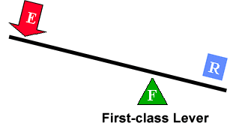
First Class Lever
Fulcrum is between EF (effort) and RF (load)
Effort moves farther than Resistance.
Multiplies EF and changes its direction
The mechanical advantage of a lever is the ratio of the length of the lever on the applied force side of the fulcrum to the length of the lever on the resistance force side of the fulcrum.

Slide 10
Chapter 8
Rotational Equilibrium
and
Rotational Dynamics

Slide 11
Torque
Torque, τ , is tendency of a force to rotate object about some axis
  F is the force
  d is the lever arm (or moment arm)
  Units are Newton-m

Slide 12
Torque is vector quantity
Direction determined by axis of twist
Perpendicular to both r and F
Clockwise torques point into paper.
Defined as negative
Counter-clockwise torques point out of paper.
Defined as positive

Slide 13
Non-perpendicular forces
Φ is the angle between F and r

Slide 14
Torque and Equilibrium
Forces sum to zero (no linear motion)
Torques sum to zero
(no rotation)

Slide 15
Axis of Rotation
Torques require point of reference
Point can be anywhere
  Use same point for all torques
  Pick the point to make problem least difficult

Slide 16
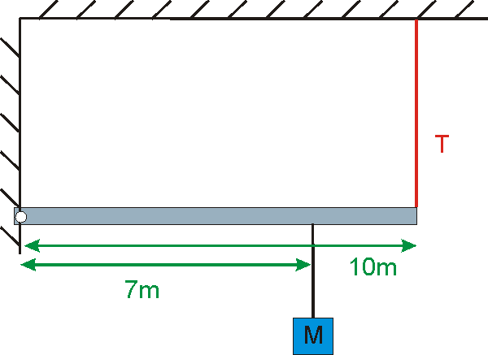
Example 8.1
Given M = 120 kg.
Neglect the mass of the beam.
a) Find the tension
in the cable
b) What is the force
between the beam and
the wall
a) T=824 N b) f=353 N

Slide 17
Another Example
Given: W=50 N, L=0.35 m,
x=0.03 m
Find the tension in the muscle
W
x
L
F = 583 N

Slide 18
Center of Gravity
Gravitational force acts on all points of an extended object
However, it can be considered as one net force acting on one point, the center-of-gravity, X.
Weighted
Average

Slide 19
Example 8.2
Given: x = 1.5 m, L = 5.0 m,
w_{beam} = 300 N,
w_{man} = 600 N
Find: T
T = 413 N
x
L

Slide 20
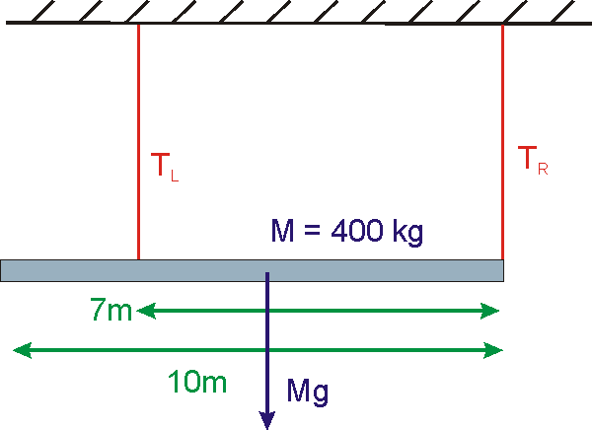
Example 8.3
Consider the 400-kg
beam shown below.
Find T_{R}
T_{R} = 1 121 N

Slide 21
Example 8.4a
Given:
W_{beam}=300
W_{box}=200
Find:
T_{left}
What point should I use for torque origin?
A
B
C
D

Slide 22
Example 8.4b
Given:
T_{left}=300
T_{right}=500
Find:
W_{beam}
What point should I use for torque origin?
A
B
C
D

Slide 23
Example 8.4c
Given:
W_{beam}=300
W_{box}=200
Find:
T_{right}
What point should I use for torque origin?
A
B
C
D

Slide 24
Example 8.4d
Given:
T_{left}=250
T_{right}=400
Find:
W_{box}
What point should I use for torque origin?
A
B
C
D

Slide 25
Example 8.4e
Given:
T_{left}=250
W_{beam}=250
Find:
W_{box}
What point should I use for torque origin?
A
B
C
D

Slide 26
Example 8.5 (skip)
A 80-kg beam of length L = 100 cm has a 40-kg mass
hanging from one end. At what position x can one balance
them beam at a point?
L = 100 cm
80 kg
x
40 kg
x = 66.67 cm

Slide 27
Torque and Angular Acceleration
Analogous to relation between F and a
Moment of Inertia

Slide 28
Moment of Inertia
Mass analog is moment of inertia, I
  r defined relative to rotation axis
  SI units are kg m²

Slide 29
More About Moment of Inertia
I depends on both the mass and its distribution.
If mass is distributed further from axis of rotation, moment of inertia will be larger.

Slide 30
Moment of Inertia of a Uniform Ring
Divide ring into segments
The radius of each segment is R

Slide 31
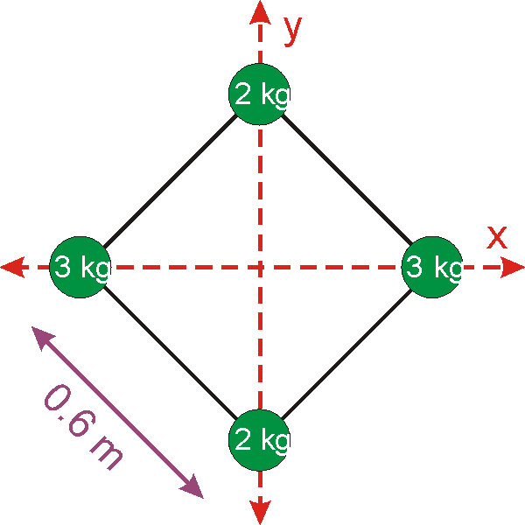
Example 8.6
What is the moment of inertia of the following point masses arranged in a square?
a) about the x-axis?
b) about the y-axis?
c) about the z-axis?
a) 0.72 kg⋅m²
b) 1.08 kg⋅m²
c) 1.8 kg⋅m²

Slide 32
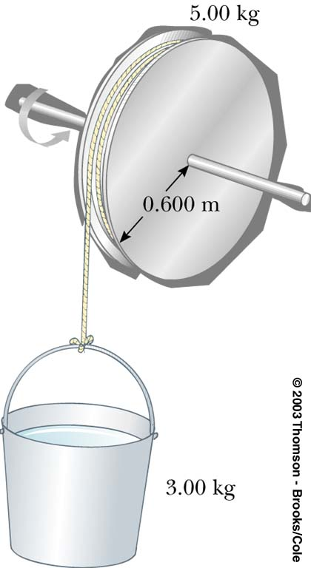
Example 8.7
Treat the spindle as a solid cylinder.
a) What is the moment of Inertia of the spindle? (M=5.0 kg, R=0.6 m)
b) If the tension in the rope is 10 N, what is the angular acceleration of the wheel?
c) What is the acceleration of the bucket?
d) What is the mass of the bucket?
M
a) 0.9 kg⋅m² b) 6.67 rad/s² c) 4 m/s² d) 1.72 kg

Slide 33
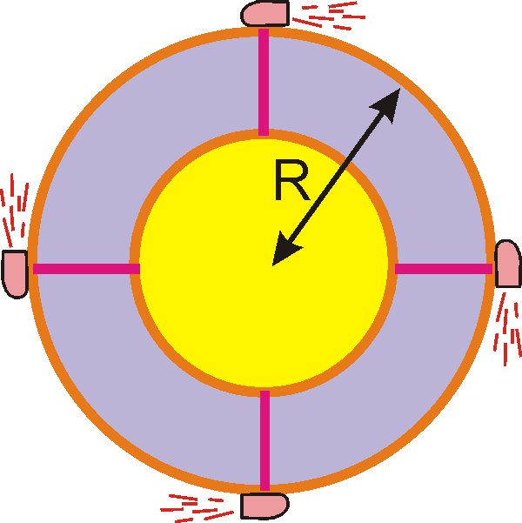
Example 8.8(skip)
A cylindrical space station of
(R=12, M=3400 kg) has moment
of inertia 0.75 MR². Retro-
rockets are fired tangentially
at the surface of space station
and provide impulse of 2.9x10⁴ N·s.
a) What is the angular velocity of the space station after the rockets have finished firing?
b) What is the centripetal acceleration at the edge of the space station?
a) ω= 0.948 rad/s b) a=10.8 m/s²

Slide 34
Example 8.9
A 600-kg solid cylinder of radius 0.6 m which can rotate freely about its axis is accelerated
by hanging a 240 kg mass from the end by a string which is wrapped about the cylinder.
a) Find the linear acceleration of the mass.
b) What is the speed of the mass after it has dropped 2.5 m?
4.36 m/s²
4.67 m/s

Slide 35
Rotational Kinetic Energy
Each point of a rigid body rotates with angular velocity ω.
Including the linear motion
KE due to rotation
KE of center-of-mass motion

Slide 36
Example 8.10
What is the kinetic energy of the Earth due to the daily rotation?
Given: M_{earth}=5.98 x10²⁴ kg, R_{earth} = 6.36 x10⁶ m.
2.56 x10²⁹ J

Slide 37
Example 8.11
A solid sphere rolls down a hill of height 40 m.
What is the velocity of the ball when it reaches the bottom? (Note: We don’t know R or M!)
v = 23.7 m/s

Slide 38
Demo: Moment of Inertia Olympics

Slide 39
Angular Momentum
Rigid body
Point particle
Analogy between L and p
Angular Momentum | Linear momentum
L = Iω | p = mv
τ = ΔL/Δt | F = Δp/Δt
Conserved if no net outside torques | Conserved if no net outside forces

Slide 40
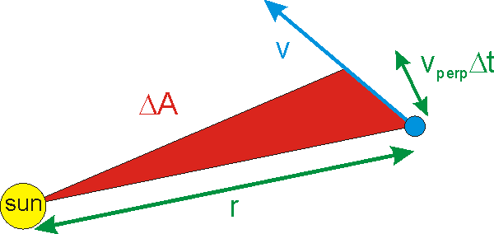
Angular Momentum and Kepler’s 2nd Law
For central forces, e.g. gravity, τ = 0
and L is conserved.
Change in area in Δt is:

Slide 41
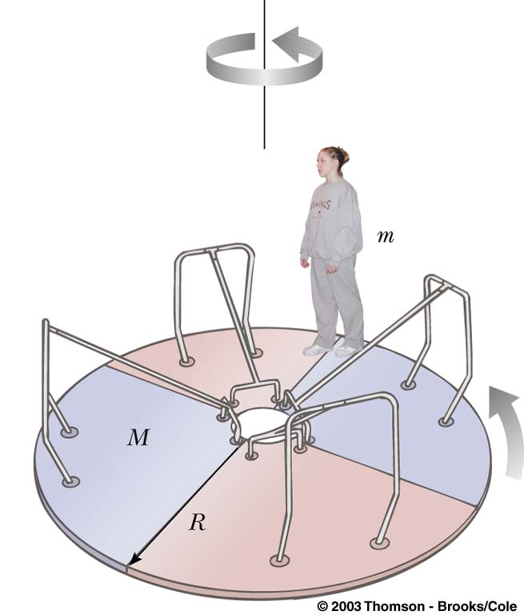
Example 8.13
A 65-kg student sprints at 8.0 m/s and leaps onto a 110-kg merry-go-round of radius 1.6 m. Treating the merry-go-round as a uniform cylinder, find the resulting angular velocity. Assume the student lands on the merry-go-round while moving tangentially.
= 2.71 rad/s

Slide 42
Example 8.14
Two twin ice skaters separated by 10 meters skate without friction in a circle by holding onto opposite ends of a rope. They move around a circle once every five seconds. By reeling in the rope, they approach each other until they are separated by 2 meters.
a) What is the period of the new motion?
b) If each skater had a mass of 75 kg, what is the work done by the skaters in pulling closer?
T_{F} = T₀/25 = 0.2 s
W = 7.11x10⁵ J

Slide 43
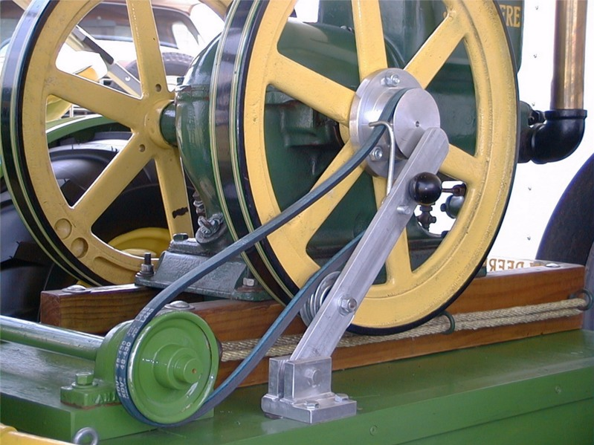
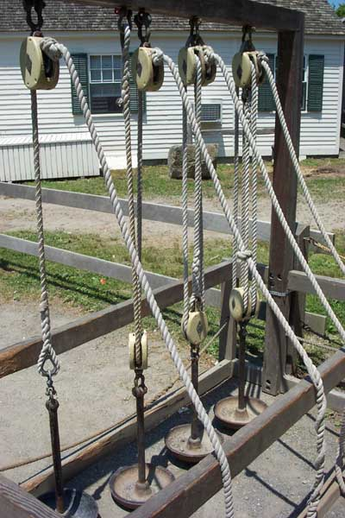
Pulleys
Pulley are wheels and axles with a groove around the outside
A pulley needs a rope, chain or belt around the groove to make it do work

Slide 44
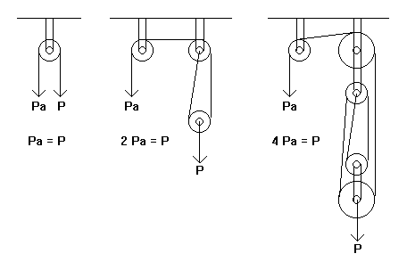
Simple Pulley

Slide 45
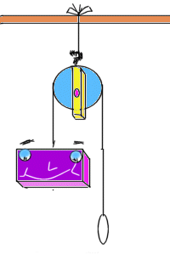
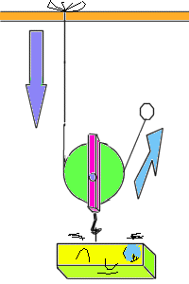
Diagrams of Pulleys
Fixed pulley:
A fixed pulley changes the direction of a force; however, it does not create a mechanical advantage.
Movable Pulley:
The mechanical advantage of a moveable pulley is equal to the number of ropes that support the moveable pulley.

Slide 46
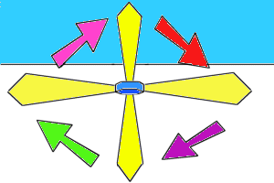
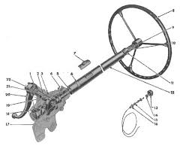
Simple Wheel and Axle
wheel
The axle is stuck rigidly to a large wheel. Fan blades are attached to the wheel. When the axel turns, the fan blades spin.
axle

Slide 47
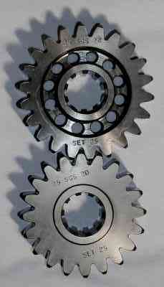
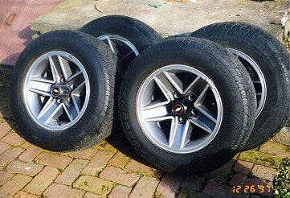
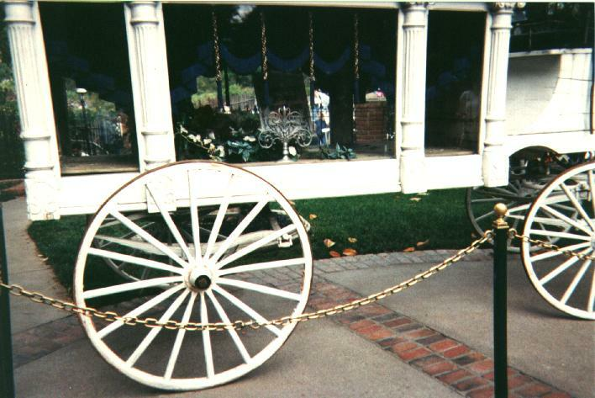
Different Wheel and Axle and Their velocity ratio
Velocity ratio (VR) = distance moved by effort
_________________________________________________________________________
distance moved by load

Slide 48
Lubrication
Friction - is created when there is relative motion between two surfaces
Resistance to motion is defined as friction
Lubrication is use of a material between surfaces to reduce friction
Any material used is called a lubricant

Slide 49
Methods of lubrication
Two main methods
  Hydrodynamic lubrication
  Boundary lubrication
Hydrodynamic lubrication
  Also called complete or full flow
  Occurs when two surfaces are completed separated by a fluid film

Slide 50
Methods of lubrication cont..
Two main methods
  Hydrodynamic lubrication
  Boundary lubrication
Boundary lubrication
  Occurs when Hydrodynamic lubrication fails.
  By adsorption or chemical reaction

Slide 51
Types of Lubricant - Physical
Liquid
Solid
Semi solid
Gases
Lube.specialist@gmail.com

Slide 52
Types of Lubricant - Physical
Liquid
  Typical lubricants are liquid/fluids
  Mineral oil or synthetic oils
Solid
  Graphite, MoS2
Semi solid
  Greases
Gases
  Atomised 2 stroke oils
Lube.specialist@gmail.com

Slide 53
Typical lubricants - Application
Engine oils
Gear Oils
Turbine Oils
Hydraulic Oils
Metal working oils
  Cutting oils
  Forming Oils
Rust preventives
Lube.specialist@gmail.com

Slide 54
Typical lubricants - Application
Heat Transfer Oils
Heat Treatment Oils
  Quenching Oils
  Tempering Oils
Refrigeration Oils
Rubber Process Oils
Ink process Oils
Lube.specialist@gmail.com

Slide 55
Lubricant - Components
Base Oils
  Mineral by-products of crude oil refining process.
  Base oils are polymerized or synthesized further and called synthetic
Additives
  Natural
  Synthetic
Lube.specialist@gmail.com

Slide 56
Function of a lubricant
Lubricate - Reduce friction
Cooling - Heat transfer
Cleaning - Detergency
Noise pollution - dampening
Sealing – prevent leakage
Protection – prevent wear
Lube.specialist@gmail.com

Slide 57
Lubricate – reduce friction
The effects of friction
  Metal to metal contact
  Leads to wear and tear
  Generates heat
  Results in Power loss
Lubricant reduces friction by forming a film
  Reduces ill effect of friction
Lube.specialist@gmail.com

Slide 58
Newton’s Laws of Motion
1st Law – An object at rest will stay at rest, and an object in motion will stay in motion at constant velocity, unless acted upon by an unbalanced force.
2nd Law – Force equals mass times acceleration.
3rd Law – For every action there is an equal and opposite reaction.

Slide 59
1st Law of Motion
(Law of Inertia)
An object at rest will stay at rest, and an object in motion will stay in motion at constant velocity, unless acted upon by an unbalanced force.

Slide 61

1st Law
Once airborne, unless acted on by an unbalanced force (gravity and air – fluid friction), it would never stop!

Slide 62
1st Law
Unless acted upon by an unbalanced force, this golf ball would sit on the tee forever.

Slide 63
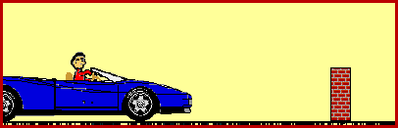
Newtons’s 1st Law and You
Don’t let this be you. Wear seat belts.
Because of inertia, objects (including you) resist changes in their motion. When the car going 80 km/hour is stopped by the brick wall, your body keeps moving at 80 m/hour.

Slide 64

2nd Law
F = m x a

Slide 65
2nd Law
The net force of an object is equal to the product of its mass and acceleration, or F=ma.

Slide 66
2nd Law
When mass is in kilograms and acceleration is in m/s/s, the unit of force is in newtons (N).
One newton is equal to the force required to accelerate one kilogram of mass at one meter/second/second.

Slide 67
2nd Law (F = m x a)
How much force is needed to accelerate a 1400 kilogram car 2 meters per second/per second?
Write the formula
F = m x a
Fill in given numbers and units
F = 1400 kg x 2 meters per second/second
Solve for the unknown
2800 kg-meters/second/second or 2800 N

Slide 68
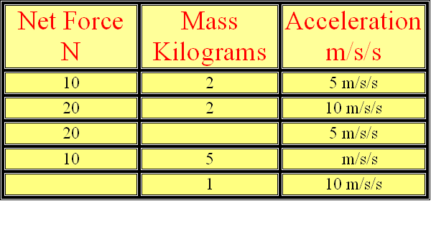
If mass remains constant, doubling the acceleration, doubles the force. If force remains constant, doubling the mass, halves the acceleration.

Slide 69
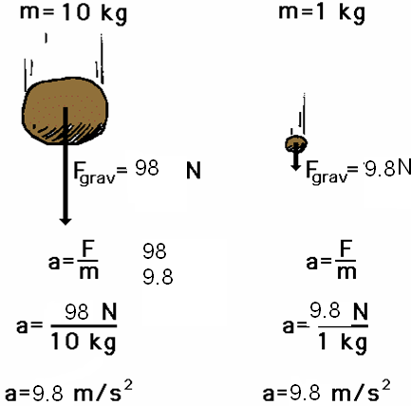
Newton’s 2nd Law proves that different masses accelerate to the earth at the same rate, but with different forces.
We know that objects with different masses accelerate to the ground at the same rate.
However, because of the 2nd Law we know that they don’t hit the ground with the same force.
F = ma
98 N = 10 kg x 9.8 m/s/s
F = ma
9.8 N = 1 kg x 9.8 m/s/s

Slide 70
Check Your Understanding
1. What acceleration will result when a 12 N net force applied to a 3 kg object? A 6 kg object?
2. A net force of 16 N causes a mass to accelerate at a rate of 5 m/s². Determine the mass.
3. How much force is needed to accelerate a 66 kg skier 1 m/sec/sec?
4. What is the force on a 1000 kg elevator that is falling freely at 9.8 m/sec/sec?

Slide 71
Check Your Understanding
1. What acceleration will result when a 12 N net force applied to a 3 kg object?
12 N = 3 kg x 4 m/s/s
2. A net force of 16 N causes a mass to accelerate at a rate of 5 m/s². Determine the mass.
16 N = 3.2 kg x 5 m/s/s
3. How much force is needed to accelerate a 66 kg skier 1 m/sec/sec?
66 kg-m/sec/sec or 66 N
4. What is the force on a 1000 kg elevator that is falling freely at 9.8 m/sec/sec?
9800 kg-m/sec/sec or 9800 N

Slide 72
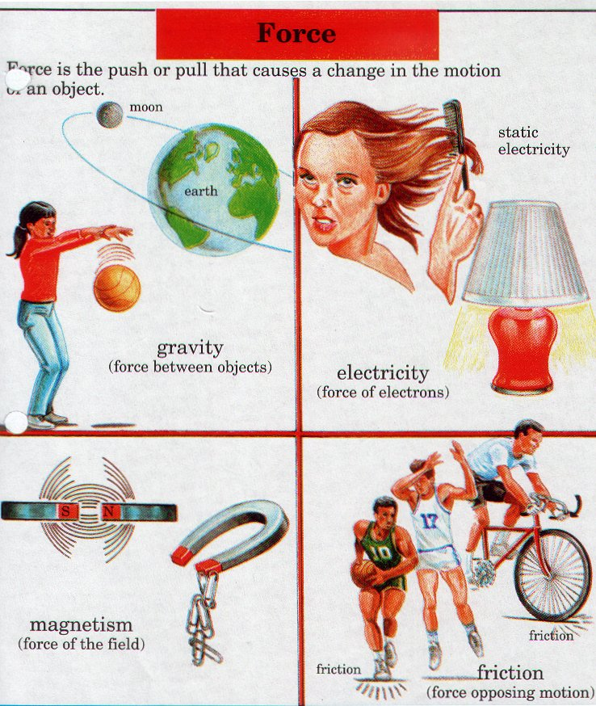

Slide 73
3rd Law
For every action, there is an equal and opposite reaction.

Slide 74
3rd Law
According to Newton, whenever objects A and B interact with each other, they exert forces upon each other. When you sit in your chair, your body exerts a downward force on the chair and the chair exerts an upward force on your body.

Slide 75
3rd Law
There are two forces resulting from this interaction - a force on the chair and a force on your body. These two forces are called action and reaction forces.

Slide 76

Newton’s 3rd Law in Nature
Consider the propulsion of a fish through the water. A fish uses its fins to push water backwards. In turn, the water reacts by pushing the fish forwards, propelling the fish through the water.
The size of the force on the water equals the size of the force on the fish; the direction of the force on the water (backwards) is opposite the direction of the force on the fish (forwards).

Slide 77

3rd Law
Flying gracefully through the air, birds depend on Newton’s third law of motion. As the birds push down on the air with their wings, the air pushes their wings up and gives them lift.

Slide 78
Consider the flying motion of birds. A bird flies by use of its wings. The wings of a bird push air downwards. In turn, the air reacts by pushing the bird upwards.
The size of the force on the air equals the size of the force on the bird; the direction of the force on the air (downwards) is opposite the direction of the force on the bird (upwards).
Action-reaction force pairs make it possible for birds to fly.

Slide 79
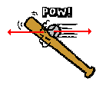

Other examples of Newton’s Third Law
The baseball forces the bat to the left (an action); the bat forces the ball to the right (the reaction).

Slide 80

3rd Law
Consider the motion of a car on the way to school. A car is equipped with wheels which spin backwards. As the wheels spin backwards, they grip the road and push the road backwards.

Slide 81

3rd Law
The reaction of a rocket is an application of the third law of motion. Various fuels are burned in the engine, producing hot gases.
The hot gases push against the inside tube of the rocket and escape out the bottom of the tube. As the gases move downward, the rocket moves in the opposite direction.

Slide 82
Motion Under Gravity
Gravity is a force of attraction between objects that is due to their masses.
All matter has mass. Gravity is a result of mass. Therefore, all matter is affected by gravity.
Gravity between the objects of the solar system holds the solar system together.

Slide 83
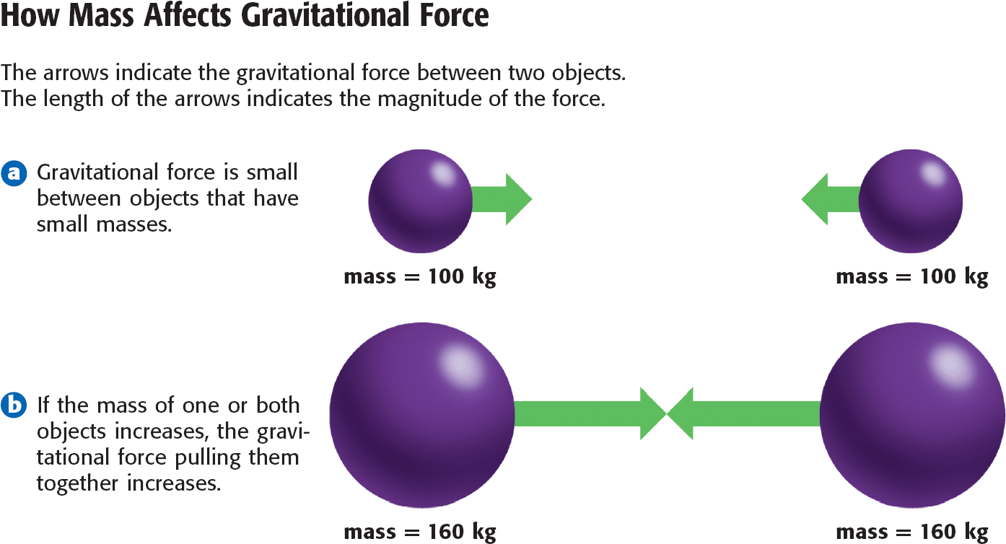
MASS: The gravitational force between objects depends on the product of the masses of the objects. So, the gravity between objects increases as the masses of the objects increases.

Slide 84
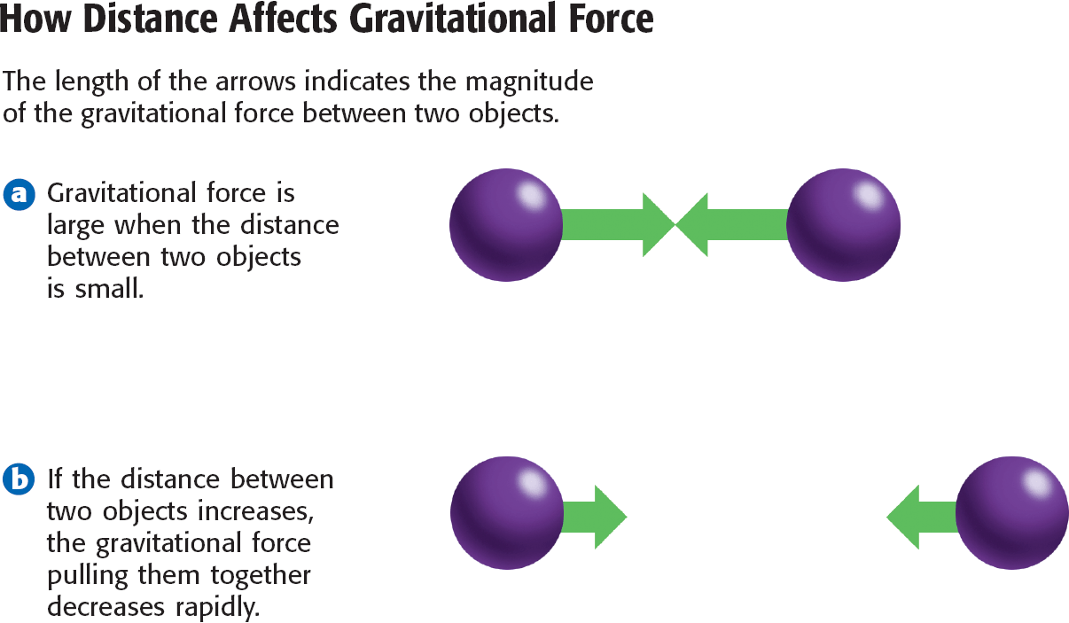
DISTANCE: The force of gravity depends on the distance between two objects.
As the distance between two objects gets larger, the force of gravity gets much smaller.

Slide 85
Where is the most gravitational attraction?
Between the two textbooks on your table or a textbook on the table and the one in your house?
Between two football players or a football player and a toddler
Between the two textbooks on the table or one textbook and the desk
Why cant we see the attraction between these objects?

Slide 86
Weight and the Gravitational Force
Weight is related to mass, but they are not the same. Weight is a measure of the gravitational force on an object.
Weight is expressed in the SI unit of force, the Newton (N).
The value of an object’s weight can change with the location of the object in the universe.

Slide 87
Numerical Problem

Slide 88
Chapter related to Textile Machinaries
Numerical Problems

