Slide 1
CHAPTER 1: WARPING
STATE THE OBJECT OF WARPING .
CLASSIFY WARPING PROCESSES .
COMPARE TWO TYPES OF WARPING -BEAM WARPING AND SECTIONAL WARPING .
EXPLAIN THE PASSAGE OF MATERIAL THROUGH A SLOW SPEED WARPING M/C .
LIST VARIOUS FEATURES OF HIGH SPEED WARPING M/CS .
ILLUSTRATE ON BEAM DEFECTS AND REMEDIES .

Slide 2
OBJECTS OF WARPING
The objective of warping is to convert a predetermined number of single end packages, such as cones or cheeses into a sheet of yarn of specified length and width. The individual ends in the warp are uniformly spaced across its full width.

Slide 3
TYPES OF WARPING
DIRECT SYSTEM OR BEAM WARPING
INDIRECT SYSTEM OR SECTIONAL WARPING

Slide 4
DIRECT SYSTEM OR BEAM WARPING
In this system ,warps are prepared by placing the individual yarn packages in a large frame called a creel .The yarns are uniformly spaced by placing them into the dents of an expanding comb of a reed and wound onto a big double flanged beam called Warper beam or Back beam . The capacity of the creel is about 400 to 500 ends .

Slide 5
CREEL
There are mainly two types of creels used for beam warping m/cs .They are ---
V-creel and
Rectangular creel

Slide 6
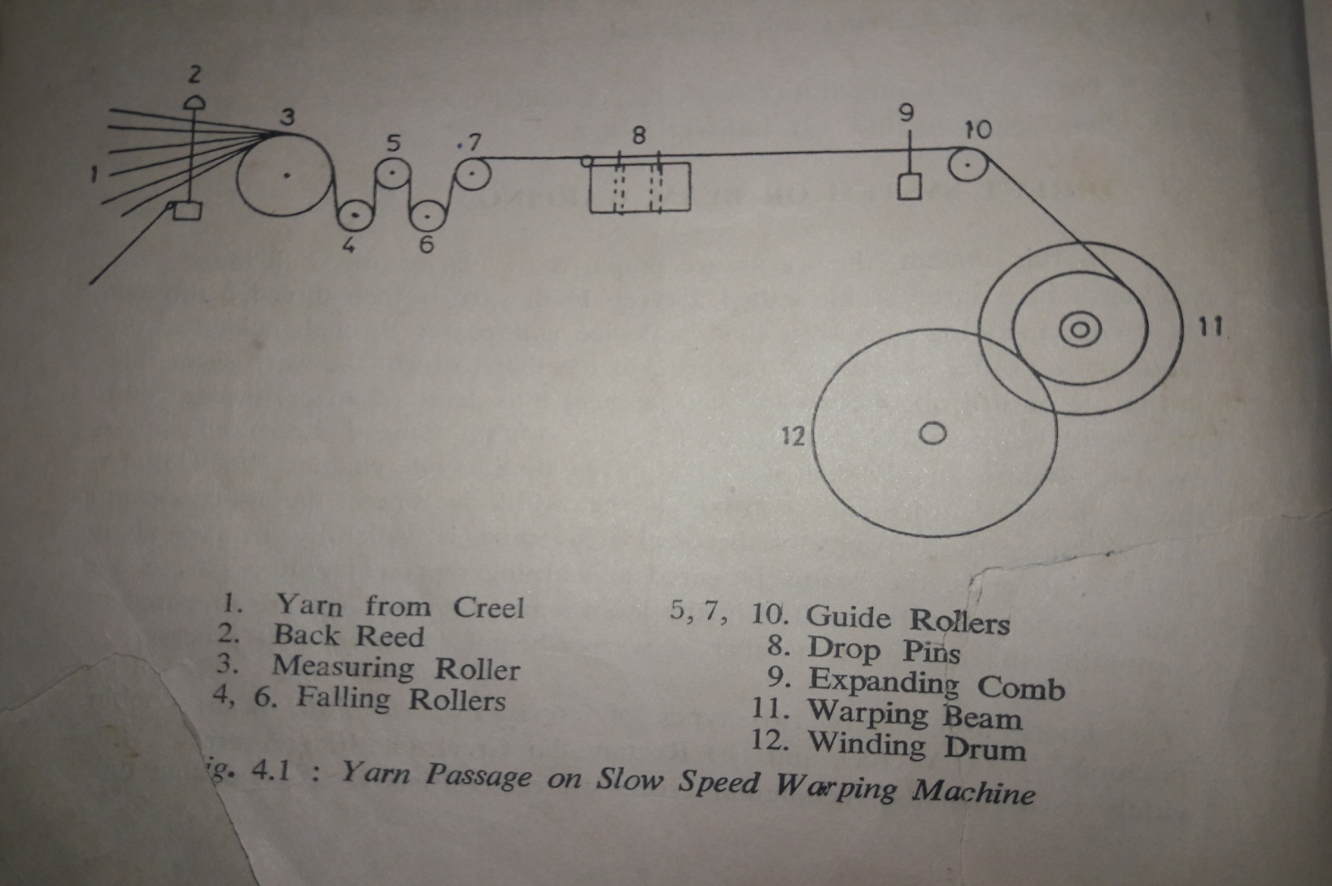
SLOW SPEED WARPING M/C

