Slide 1
Yarn manufacture-iii
SPEED FRAME

Slide 2
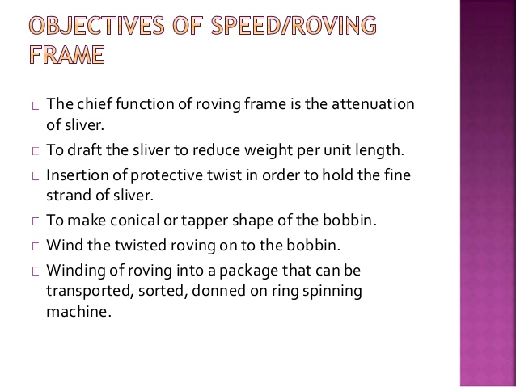

Slide 3
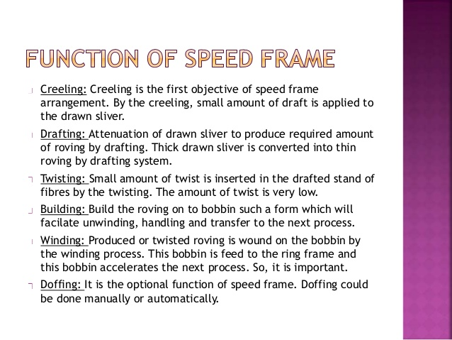

Slide 4
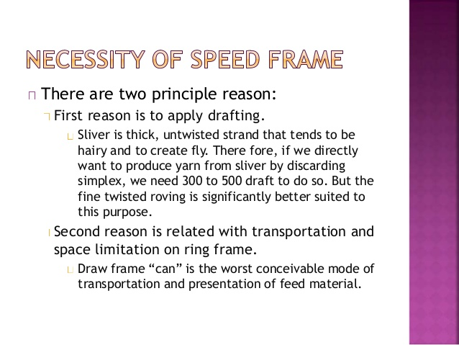

Slide 5
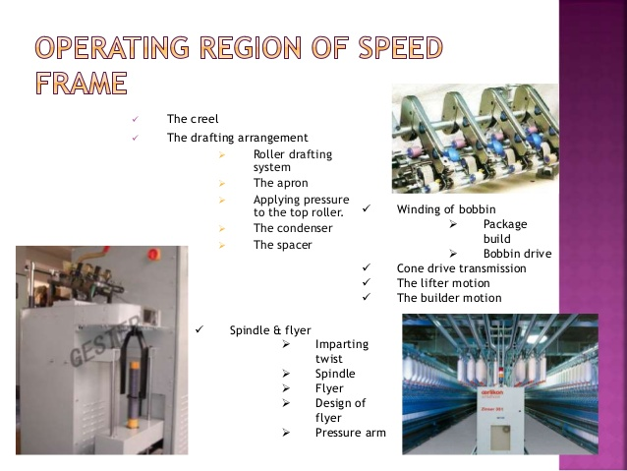

Slide 6
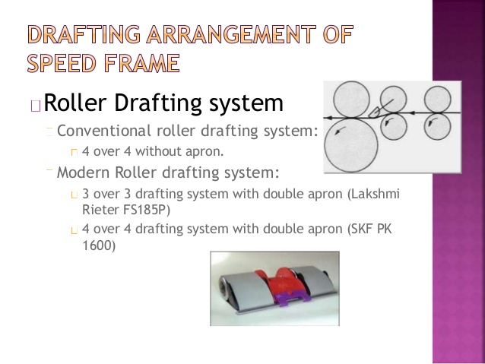

Slide 7
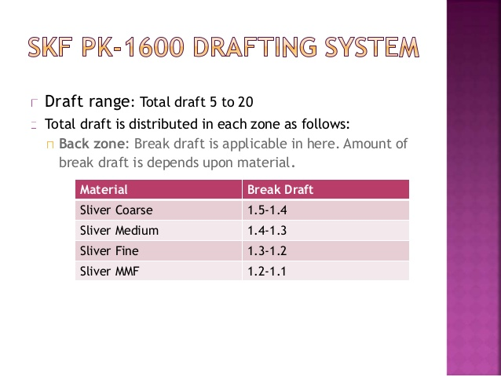

Slide 8
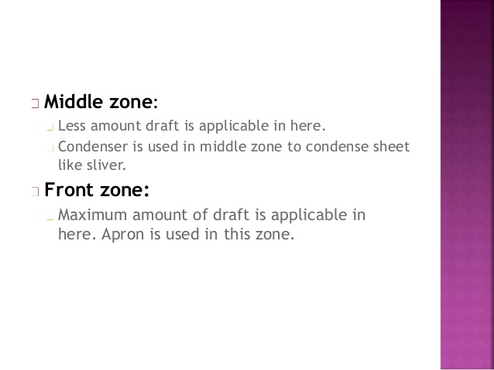

Slide 9
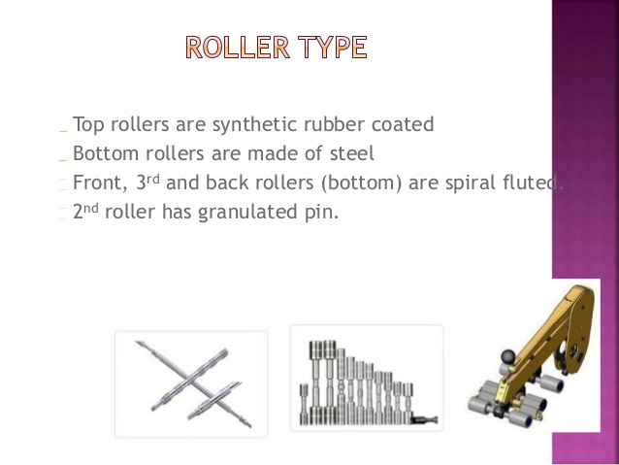

Slide 10
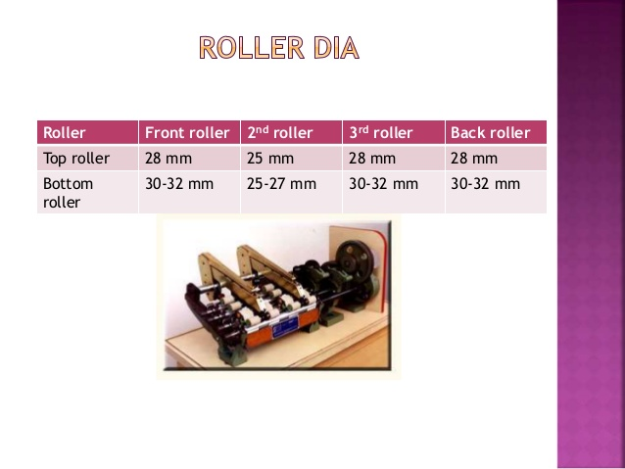

Slide 11
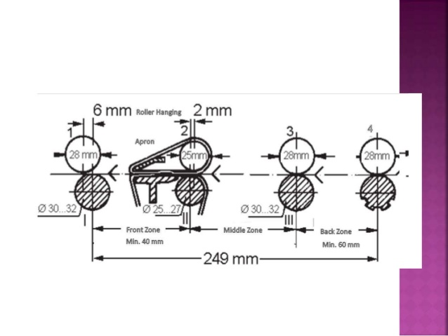

Slide 12
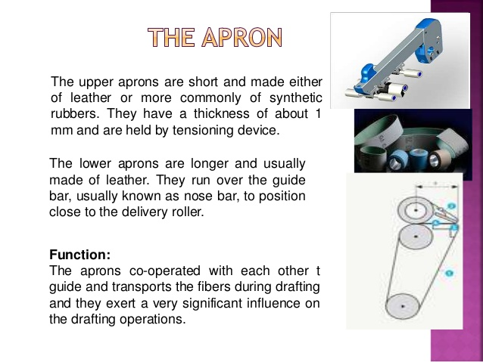

Slide 13
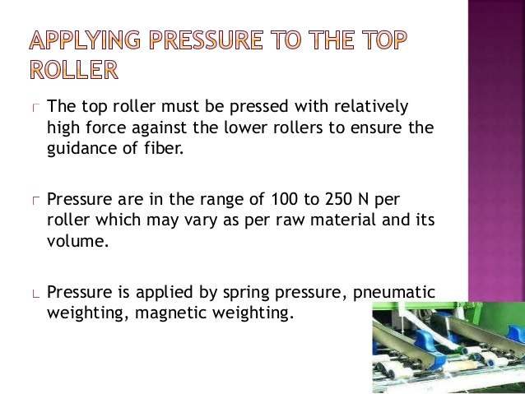

Slide 14
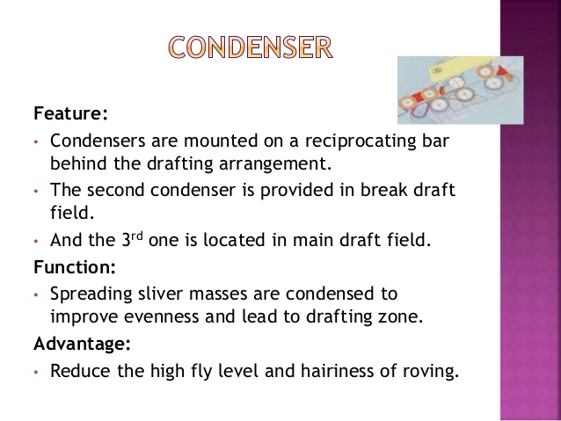

Slide 15
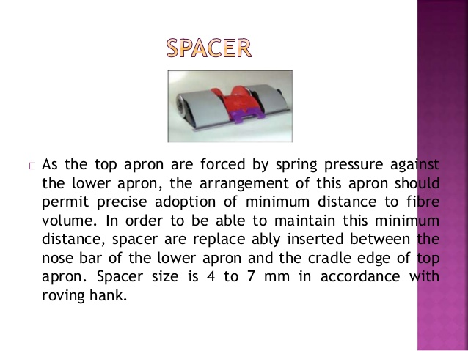

Slide 16
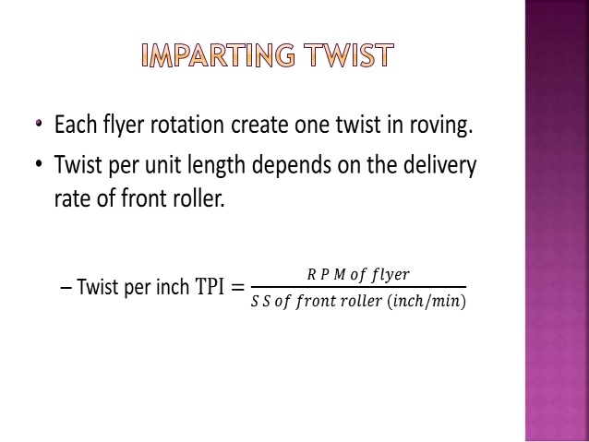

Slide 17
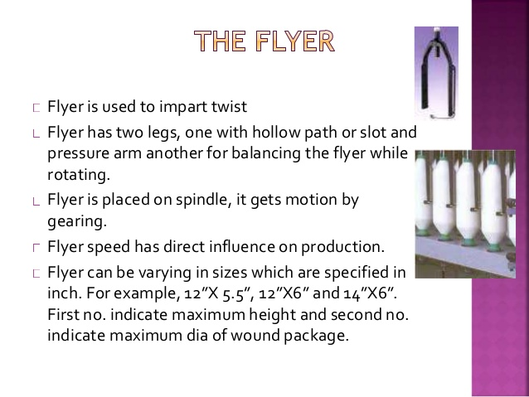

Slide 18
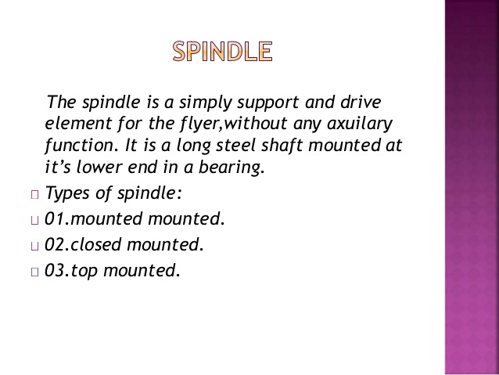

Slide 19
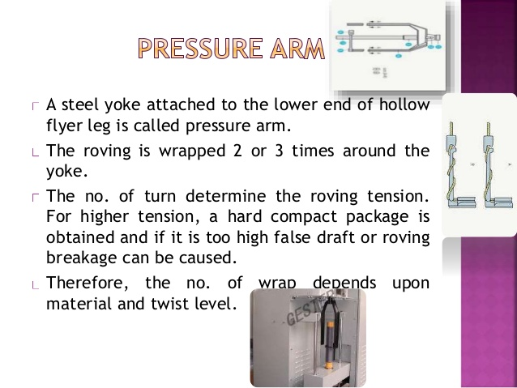

Slide 20
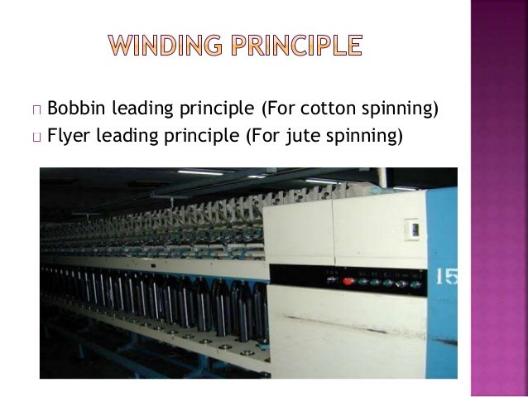

Slide 21
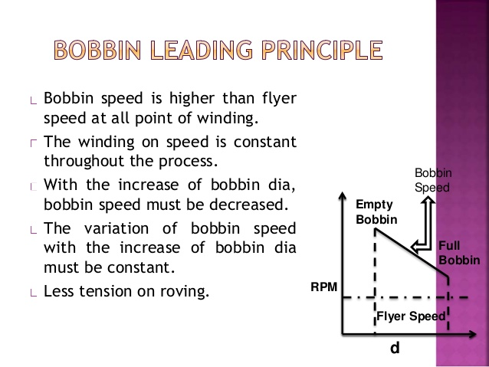
Notes:
In point 3&4 it should be bobbin RPM instead of bobbin speed.

Slide 22
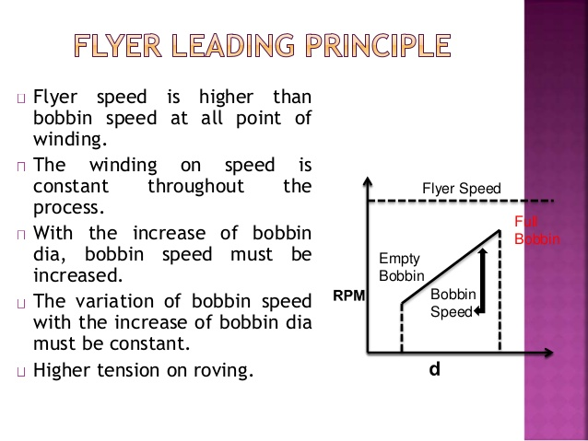
Notes:
In point no 3&4 it should be bobbin RPM instead of bobbin speed.

Slide 23
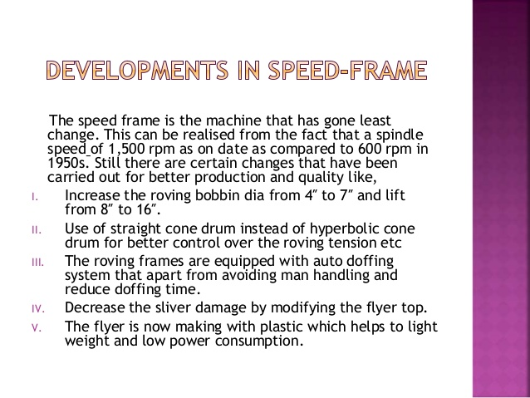

Slide 24
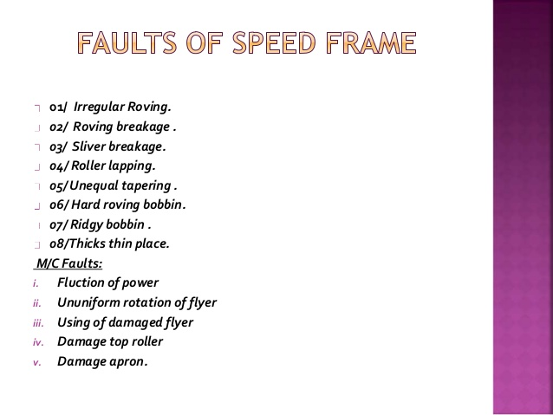

Slide 26
WINDING
FOR WINDING TO TAKE PLACE WINDING RATE MUST ALWAYS BE EQUAL TO THE DELIVERY RATE.
Notes:
DELIVERY RATE IS THE RATE OF FRONT ROLLER DELIVERY.

Slide 27
WINDING
WINDING IS TAKING PLACE ONLY BECAUSE THERE IS A DIFFERENCE IN SPEED BETWEEN BOBBIN AND FLYER
BOTH THE BOBBIN AND FLYER ARE ROTATING IN THE SAME DIRECTION.
WINDING RATE IS THE DIFFERENCE BETWEEN BOBBIN SPEED AND FLYER SPEED.

Slide 28
BUILDING MECHANISM-1
FUNCTION:-
LAYING OF COILS JUST NEXT TO THE PREVIOUS COIL,(WITHOUT OVERLAPPING & GAP INBTWEEN COILS)
REDUCE BOBBIN RPM AS DIA OF BOBBIN INCREASES.
MAINTAIN THE TAPPERING ANGLE OF BOBBIN
ACTIVATE THE REVERSING MOTION.

Slide 29
CONE DRUMS
TOP CONE DRUM IS DRIVER, BOTTOM CONE DRUM IS DRIVEN.
TOP CONE DRUM GETS MOTION FROM MOTOR VIA TRAIN OF GEARS.
RPM OF TOP CONE DRUM IS CONSTANT

Slide 30
CONE DRUMS
RPM OF BOTTOM CONE DRUM GOES ON REDUCING AS ROVE IS WOUND ON BOBBIN (BELT ON CONE DRUM IS MOVED AT THE END OF EACH TRAVERSE BY BUILDING MECHANISM)
BOTTOM CONE DRUM GIVES DRIVE TO BOBBIN RAIL AND DIFFERENTIAL GEAR BOX

Slide 31
CONE DRUMS
THIS IMPLIES THAT THE RATE OF MOVEMENT OF BOBBIN RAIL DECREASES AS PACKAGE DIA INCREASES.
THIS REDUCTION IN RATE OF BOBBIN RAIL MOVEMENT IS RESPONSIBLE FOR MAINTAINING THE NUMBER OF COILS PER UNIT LENGTH, SAME, THROUGHOUT THE PACKAGE.

Slide 32
BUILDING MECHANISM-2
THE BUILDING MECHANISM GETS DRIVE FROM THE BOBBIN RAIL VIA THE POKER BAR.
THE DIRECTION OF MOVEMENT OF BOBBIN RAIL IS CHANGED BY THE REVERSING GEAR AT THE END OF EACH TRAVERSE.(TRIGERED BY BUILDING MECHANISM).

Slide 33
DIFFERENTIAL GEAR BOX
GETS MOTION FROM TWO SOURCES –motor and bottom cone drum.
IT ADDS UP BOTH THESE TWO MOTIONS AND GIVES DRIVE TO THE BOBBIN.
AS BOTTOM CONE DRUM RPM REDUCES AS MORE AND MORE ROVE IS WOUND ON THE BOBBIN, THE RPM OF BOBBIN ALSO REDUCES.

Slide 34
BOBBIN SPEED
SURFACE SPEED (π D N) OF BOBBIN IS CONSTANT .
AS DIA INCREASES RPM DECREASES SO THAT THE PRODUCT IS SAME.- for example
12x1=12, 6x2=12,4x3=12,3x4=12,2x6=12,
1x12=12.
DUE TO THIS WINDING RATE = DELIVERY RATE.

